Slide 1


CASE STUDY REPORT
Team : Data_degea
College : NIT Rourkela
Ashis Kumar Parida Alyal Samal
1

Slide 2
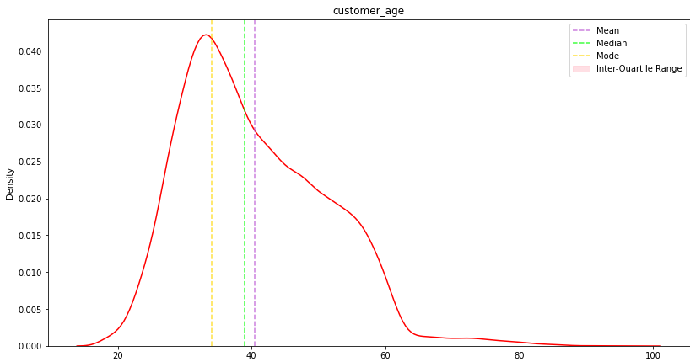
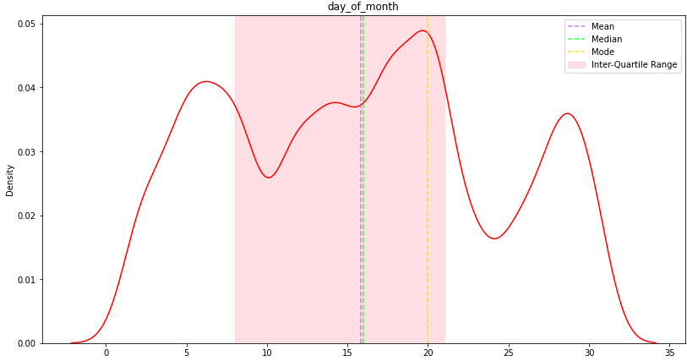

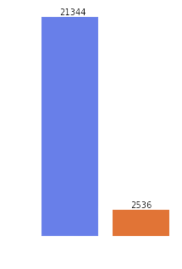
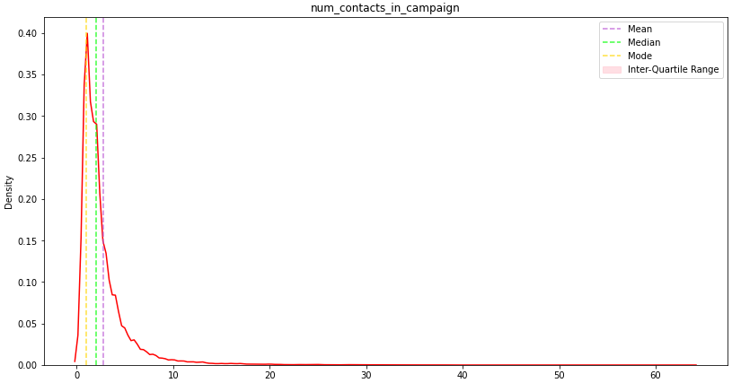
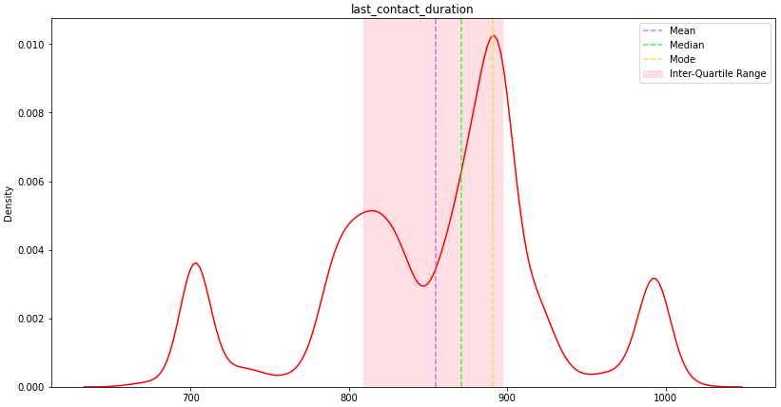
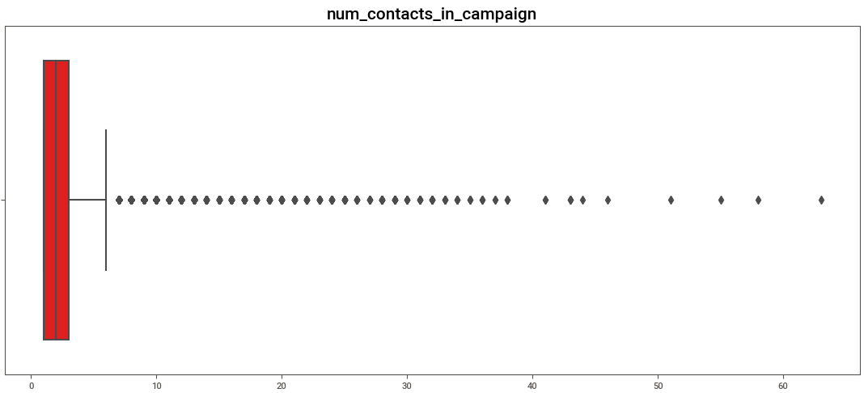
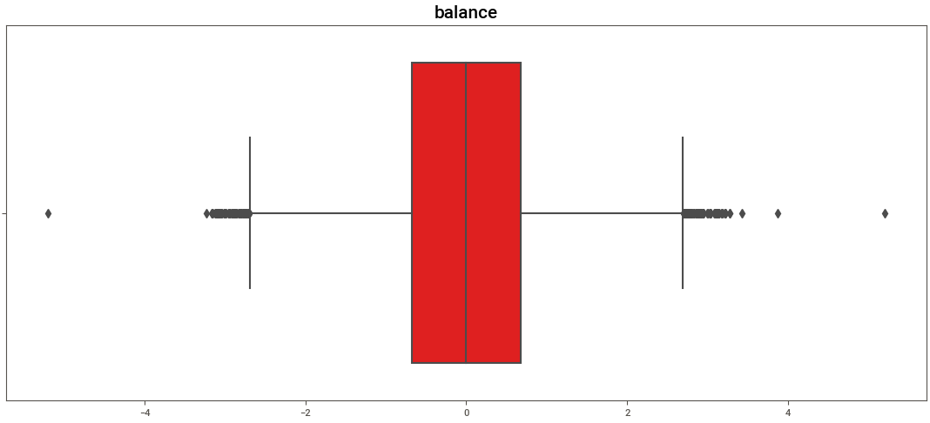

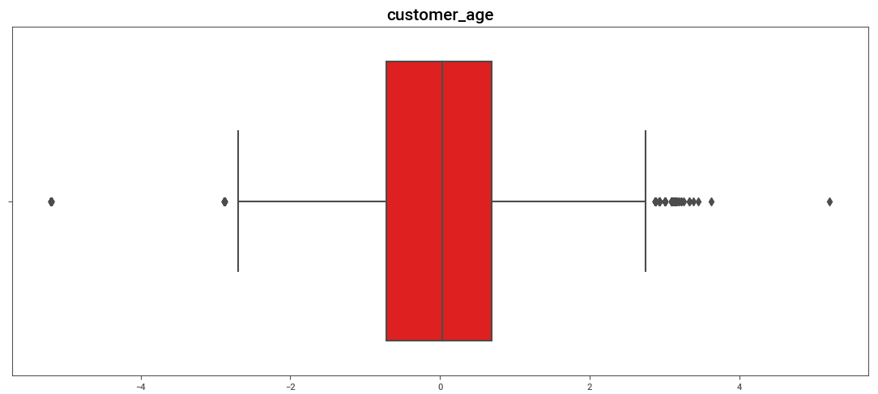
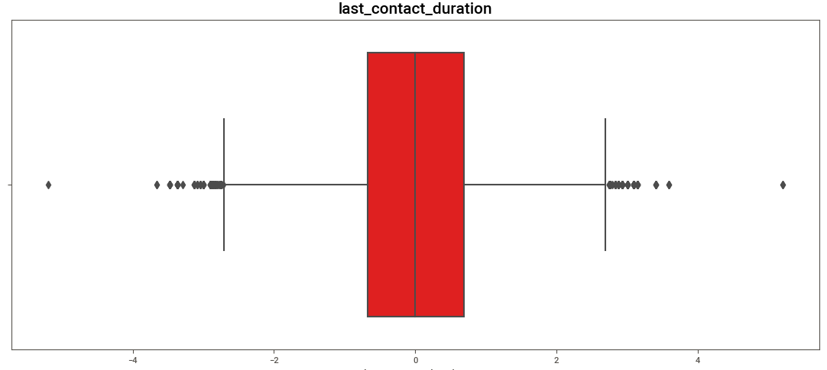
SOME COMMON GRAPHS OF DATA
UNDERSTANDING THE PROBLEM STATEMENT
KDE Plots
'' A firm has launched a new investment product "Term Deposit" which has
observed rapid growth since its inception. Based on this performance, it wants to increase its term deposit accounts amongst existing customers. To do so, it plans to run a campaign and wants EXL to identify a list of customers. ''
As the problem statement wants us to predict the top 1000 customers who would open a Term deposit account, we started with predicting probabilities for each customer and then arranging them by increasing probabilities.
At last, we selected the top 1000 customers with the highest probabilities.
Box Plots
We then decided to maximize the ROC-AUC Score, so our focus was to increase the area under the ROC curve.
We then decided to maximize the ROC-AUC Score, so our focus was to increase the
area under the ROC curve. predict the probabilities for each class instead.
2

Slide 3






SOLUTION DESIGN / PIPELINE
BOX
Plots
Hypthesis Testing
KDE
Plots
Correlation Plots
Analysis
Gaussian Mixture
80-20 Split with stratification of Target
MODELLING
Label Encoding
XGBOOST
Hyper-Parameter Tuning
With Optuna
last_contact_duration
&
customer_age
All Caregorical Features Except
'marital' & 'personal_loan'
Quantile Transformer
CatBoost
NaN Value Imputation
By
Iterattive Imputer
+
Missing Value Indicator
DATA
LightGBM
Blended Model
'marital' &
'personal_loan'
balance
Sorting Top 1000 Values &
Getting
FINAL OUTPUT
Predict Probabilities
Mapping with
Custom Dictionary
3

Slide 4
DATA PROCESSING AND TREATMENT
ENCODING THE CATEGORICAL FEATURES
We have label encoded all the categorical features except 'marital' & 'personal_loan' columns. We have mapped the two columns to numerical because these two had NaN values.
Then we dealt with them in the same way as we should treat numerical values.
IMPUTING THE NAN VALUES
We noticed that some columns of the data had many instances of null values.
So, we decided to impute them using iterative imputer with missing values indicator.
Most of the time the missing values are not randomly distributed across observations but are distributed within sub-samples.
BINNING DISTRIBUTIONS WITH GAUSSIAN MIXTURE
We obseved that the columns named 'last_contact_duration' and 'customer_age' had multimodal disrtribution, so we decided to bin the values before transforming them with different kind of transformers. Here are the results we got:
V. TRANSFORMATION OF COLUMNS
Finally we checked the skew-ness of columns and decided that 'last_contact_duration', 'customer_age' and 'balance' columns should be transformed by quantile transformer.
BEFORE TRANSFORMATION
AFTER TRANSFORMATION
IV. SCALING THE VALUES
We have observed that the features of our data has values of different scale. In order to have a uniformity of values, we decided to use Robust Scaler.
This will also help us yield better results with distance based algorithms.
4
VI. DEALING WITH CLASS IMBALANCE
As we earlier seen that the target value is very much imbalanced, so we decided to use oversampling strategy by using algorithms like SMOTE and ADASYN for algorithms which are not tree based.
For tree based algorithms, we used their built-in parameters to make the algorithm treat data as a balanced one.

Slide 5
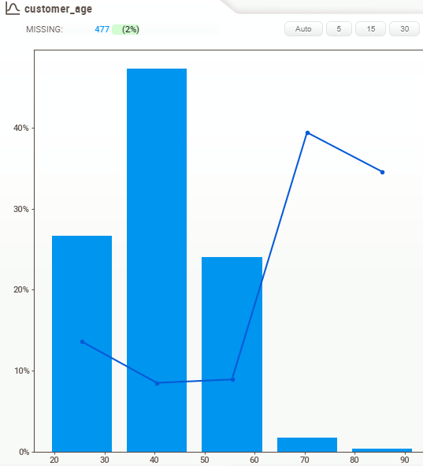
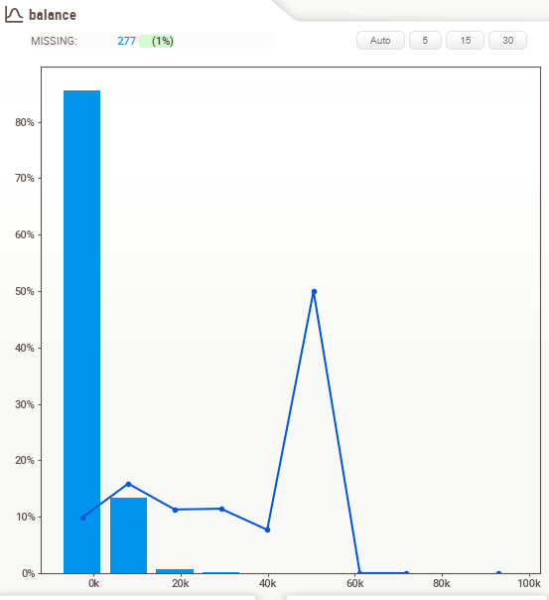
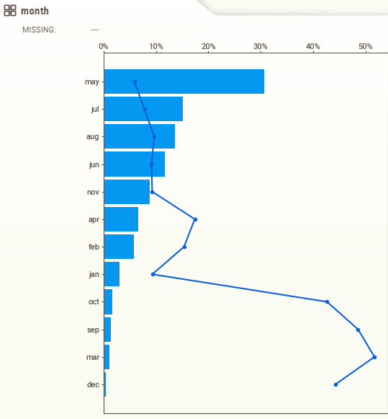
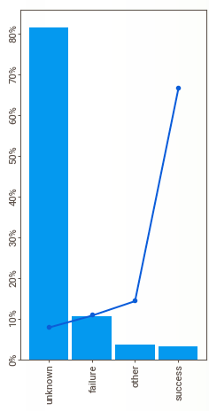

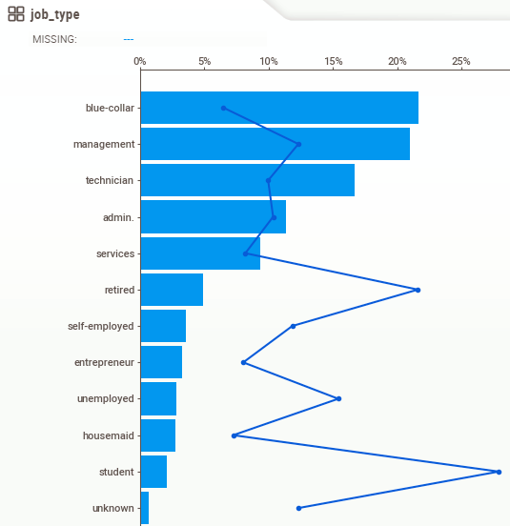
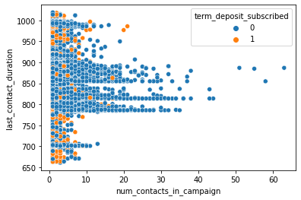
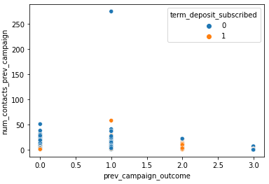
DATA VISUALIZATION
Bar Plot
% term_deposit_subscribed
Bar Plot
% term_deposit_subscribed
From this graph, we can observe that when the call duration is in 800-900 range, then only there is a surge in number of contacts in campaign. We can also observe that when the last contact duration is either very high or very low, then there are higher percentage of people who have subscribed for term lead.
From this graph, we can observe that when previous campaign outcome was a failure
, then also a higher percentage of that group has subscribed for Term Deposit, even if they were contacted very less no. of times in the previous campaign.
5

Slide 6
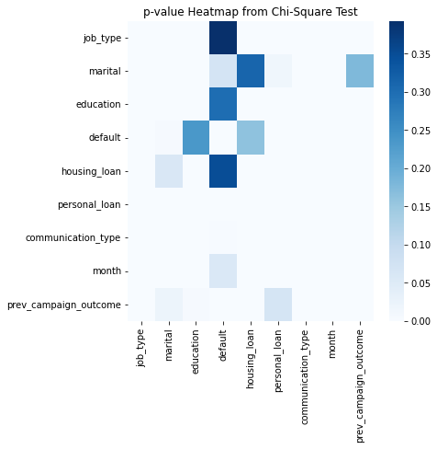
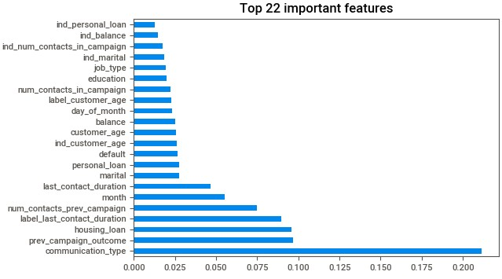
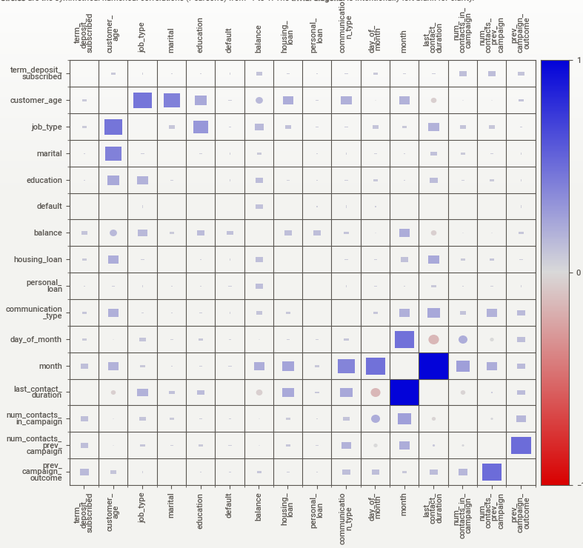
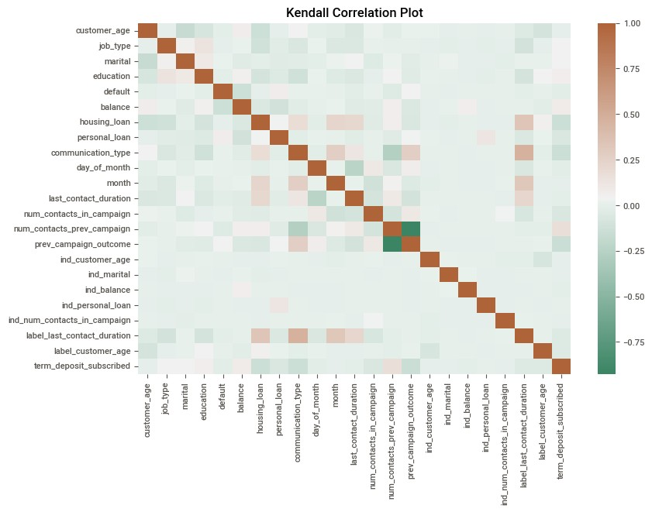
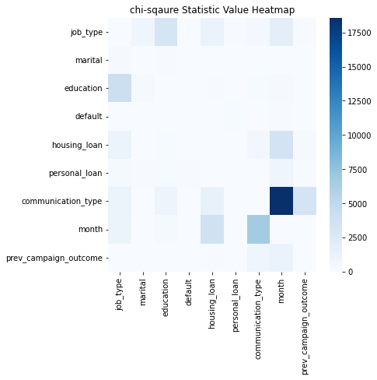
IDENTIFYING THE FACTORS THAT CONTRIBUTED THE MOST IN TERM DEPOSIT ACCOUNT OPENING
CHI-SQUARE TEST GRAPHS
Squares are categorical associations (uncertainty coefficient & correlation ratio) from 0 to 1. The uncertainty coefficient is asymmetrical, (i.e. ROW LABEL values indicate how much they PROVIDE INFORMATION to each LABEL at the TOP).
Simply, the more these values diverge from each other, the higher the chi square score, the more
likely it is to be significant, and the more likely it is
we'll reject the null hypothesis and conclude the variables are associated with each other.
This Feature Importance graph is generated by XGB Classifier.
This signifies what features are the most important while predicting the target.
Circles are the symmetrical numerical correlations (Pearson's) from -1 to
1. The trivial diagonal is intentionally left blank for clarity.
Prearson's Correlation
If any of the column's dependency with the target column is greater than its dependency with another column, then we consider the latter one, because we don't want the interference of that variable while determining the target column value
ashiskumarparida73@gmail.com
alyalsonu@gmail.com
THANK YOU
We have also checked Kendall's tau as Pearson correlation can capture linear relations only and Spearman's rho is more sensitive to errors and discrepancies in the data. When data is normal, Kendall's tau has smaller gross error sensitivity and smaller asymptotic variance.
CONTACT
US
We thank EXL Services for conducting such an amazing competition where results are
not just based on models, but also take into account data analysis, which is crucial for a
data scientist. We have thoroughly enjoyed participating in the competition. Please hold
6
more such competitions !!

